Slide 1

Beyond Digital Security 101
What else ?
Sam Ng
Sinar Project is a civic tech initiative using open technology, open data and policy analysis to systematically make important information public and more accessible to the Malaysian people.
Knowledge Management
& Community Officer
Notes:
What is digital protection strategy?
- digital (data)
- protection
- strategy
How to protect your “data”?
Risk assessment
Myth of Perfect & Permanent security
Digital hygiene and account security
Mobile secirorty
Online safety
Secure Communication & Email hygiene
Phishing: Understanding & Preventing Attacks

Slide 2


Who? User Personas
Data Analysts /
Researchers
Journalist /
Editor
Civil Society Activists
Legal Experts /
Lawyers
Social Media
Influencers
Human Rights
Victims
User story: As a ____ , I will _____, so that ____

Slide 3
Scenario/DS Game (Starting Situation)
This morning rumours were spread about potential exposure that a cabinet minister was implicated along with prominent politicians and businessmen, in a large scheme siphoning off billions in profit from a national infrastructure project. It also involves a foreign country that has strong economic ties with the country.
Social media is buzzing.
In response, MCMC has been reporting on their official social media accounts the investigations and arrests of some individuals for misinformation.
The Home Minister has put out a statement that anyone spreading rumours that are detrimental to national security will be investigated and arrested.
One member of your group has access to the data and evidence. And your group has to communicate and decide how to make this information public

Slide 4
Scenario/DS Game (Starting Situation)
Task: Come up with a plan on how to expose the news or evidence, and stay safe
What’s the best way to safely share it within the group digitally and/or physically?
What’s the best way to get the information out to the public?
Security measures you might take to protect the group, and also individually given different circumstances

Slide 5
Scenario/DS Game (Ongoing Situation)
The next day information is now everywhere on social media, some true, some not. A popular artist has been arrested for posting a caricature of the communications minister. Even the uncles at the kopitiam are talking about the issue, they heard about some Tik Clock app or something that their grandkids are sharing on their phone. Your mom is forwarding stuff on the family Whatsapp group.
Gerakan Politikus Semua Korup (GPSK) has been calling for mass protests in Kuala Lumpur. BKB members say they will join.
Berita Mingguan, another independent media outlet’s office, has been raided. Their websites were blocked, Tick Clock has been told by the communications minister to remove any content related to the issue. The newsroom fears their website and social media accounts will be next.
In the afternoon, some youth activists have started to gather and protest in front of parliament. The police are not arresting, but taking photos and recording the protesters.
The influencer in your group has pre-emptively leaked small parts of the story that they know, and is getting a million views on Tik Clock (and very happy about the attention). Everyone is following the account and the influencer has reached out to the newsroom that they’re willing to share the rest of whatever the newsroom has.
The newsroom decides they have to get the news out with the evidence they have verified.

Slide 6
Scenario/DS Game (Ongoing Situation)
Task: How are you getting the information out safely?
Are you still sticking to the original plan?
Any security changes given the changing situation?

Slide 7
Scenario/DS Game (Post Situation)
The news/information has now been published.
More arrests of posts on social media have been reported. The newsroom has been raided and equipment seized. The Editor and Journalist have been called up by police for investigations, and are told to assist in investigations by giving access to their social media accounts and their online drives.
The Researcher/Data Analyst has quit their job suddenly, to take up a prominent and high paying role at Majlis Commerce Antarabangsa. A press statement has been released that they support a full investigation but reiterate that the project is of vital interest for the Malaysian economy and local businesses

Slide 8
Scenario/DS Game (Post Situation)
Photos of protestors and associated social media influencers have been published in the newspaper, and police as wanted for investigations under multiple laws. Unknown groups have been doxxing and spreading information on persons reported by the police.
A member of BKB has red paint splashed on their car, with the words “Jangan Cabar Bossku!”
There are real fears now that the sources and those with the original information and evidence will be investigated and charged. Influencer so far has been spared, but worried they will be next.
But there also seems to be backlash against the politicians in the case. The situation is fluid and you’re all not sure what will happen over the next few days.

Slide 9
Scenario/DS Game (Post Situation)
Task: How did your previous preparations prepare (or not prepare) you for this situation?
How much do you trust the Data Analyst Consultant now? Did you have a copy of the contents of the USB?
How might you have done things differently?
Are there additional security measures, resource you think would have been helpful at this stage or previously?

Slide 10
Scenario summary (Group 1)
Starting SItuation
  Leak- Data Analyst pass through Signal for verification.
  Intern shares to news agency in a foreign country
  Risk mitigation for intern. Contact Shelter City in Amsterdam to temp shelter.
Ongoing SItuation
  Newsroom - backup data & killswitch.
  Backups outside office.
  Killswitch completely deleted data if something happens.
Post Situation
  Mask up (No photos of person), deleting up & backup.
  SS - Did not prioitise safety, backup first.
  Influencer not affected but may be in danger.

Slide 11
Scenario summary (Group 2)
Starting Situation
  Info must go through physically through USB out of country
  Leak to NY- WSJ
  Did not discuss about deleting cos its “leaked by WSJ”
  Communication: ProtonMail. Signal: password. Email: Various roles will use a single email account to discuss using various features-drafts, emails based on pre-agreed methods.
  WSJ said this, that
Ongoing Situation
  Faces online
  Data analyst has multi copies, including one copy leaked to WSJ
  Influences ir protected
  Group of influencer rather than one only to reduce risk (coalition)
  Usage of Tails OS (tool for safe operation of laptop without leaving traces)
Post Situation
  Did not discuss on faces
  Counternarrative? But the other side may be violent

Slide 12
Strategy

Slide 13
Imagine
Other common personas …
Other similar scenarios

Slide 14
Who? User Personas
Child rights
Women’s rights
Animal Rights
Judge
Educators
Environmentalists
User story: As a ____ , I will _____, so that ____

Slide 15
Who? User Personas
Police / Army /Navy
(Law Enforcement)
MCMC / Misc Commissions
(Regulators)
Extremists / Haters
Politicians
Immigration
Customs
User story: As a ____ , I will _____, so that ____

Slide 16
Who? User Personas
Big Tech
Apple
Microsoft
Meta - Facebook
Alphabet - Google
Cloudflare
User story: As a ____ , I will _____, so that ____

Slide 17
Back to the basics
Set of practices
  Mapping data assets
  Data classification & sharing
  Risk assessment
  Mitigating risks
Not about buying software
It’s protecting your most important assets “crown jewels”
Tips over Tools

Slide 18
OTC 2025 - Data Classification
Discussion
  CONFIDENTIAL/SECRET
  (For recipients only-/no sharing, huge/devastating impact if leaked limited. May cause shutdown of org)
  INTERNAL
  (Limited recipients & sharing-For organisation, partners/collective use only, large impact if leaked - limited/segment your sharing. May affect critical activities)
  PRIVATE
  (Limited recipients & sharing or individuals, organisation, partners & their community only. Some impact if leaked/shared. Things still go on but not as badly affected till org failure)
  PUBLIC
  No Limits. Is available on website
Notes:
Be aware at all times, what your data (whatsapp messages, emails, thumbdrive, laptop). Most will be at Internal or Private.
Focus on
https://github.com/Sinar/knowledgemgmt/issues/6

Slide 19
Tips over tools?
Imagine - AI?
access to:
Donor List & Contacts
Project Docs (proposals, comms)
Research & Reports

Slide 20
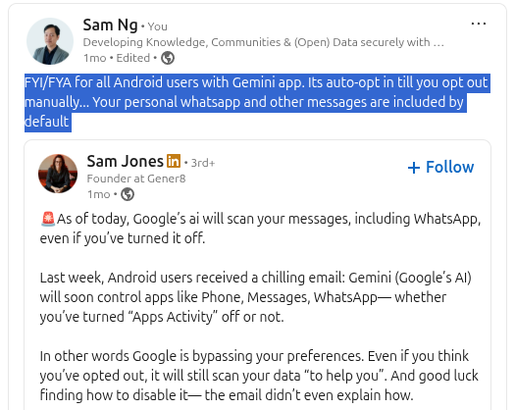
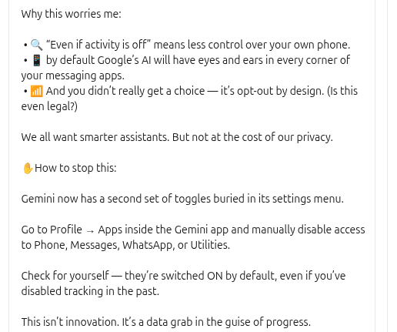
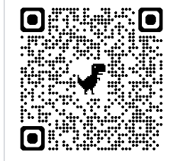
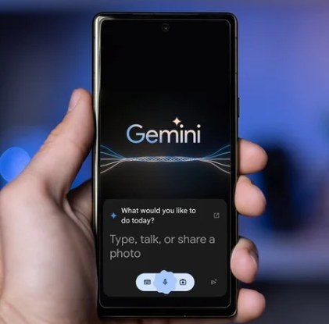
Tips over tools? AI (Mitigate! Change settings)
https://www.linkedin.com/posts/samngnet_as-of-today-googles-ai-will-scan-your-activity-7348368423707430912-rgyc
Notes:
You may need to add me on linkedin first to see the context of my posts but you can disable whatsapp and access to other apps on your phone with the above instructions.
https://www.linkedin.com/in/samngnet/
Gemini on Android picture from https://www.phonearena.com/news/gemini-for-android-gets-direct-image-sharing-into-the-app_id163324

Slide 21
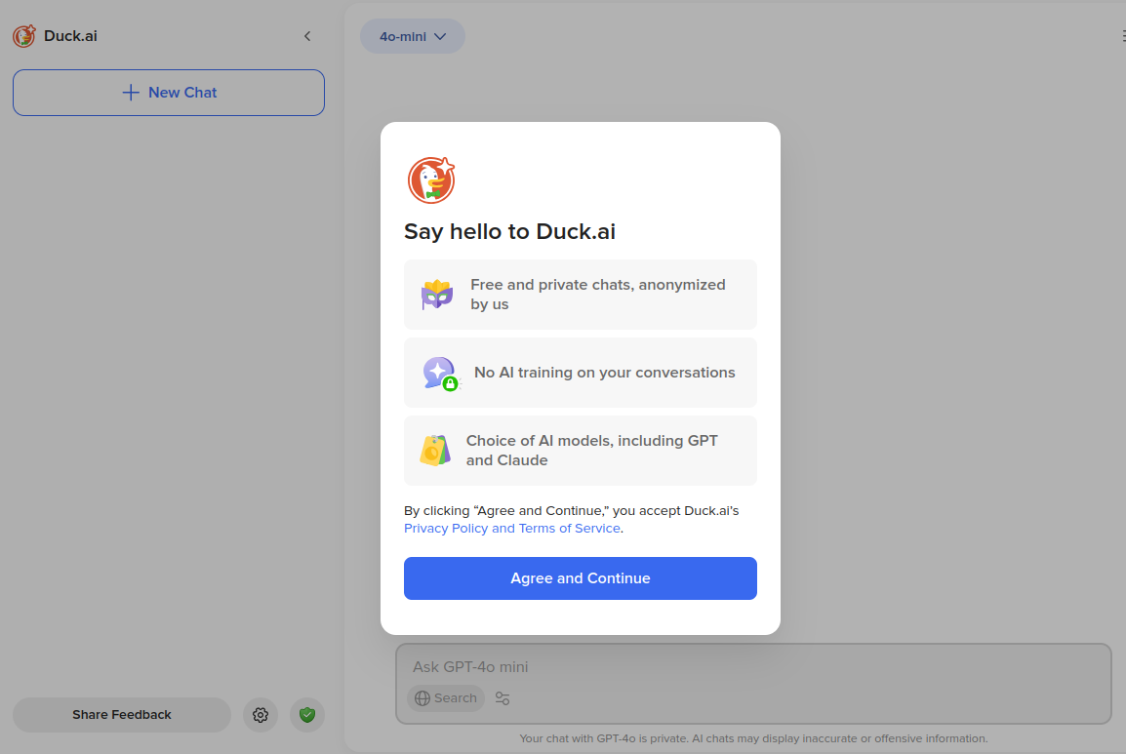
Tips over tools? duck.ai
(Risk - Chat in the cloud tied to your email account!
Mitigate! Change & Use duck.ai instead of ChatGPT or Anthropic Claude from their sites)
Privacy Centric chatgpt, claude https://duck.ai
Notes:
You may need to add me on linkedin first to see the context of my posts but you can disable whatsapp and access to other apps on your phone with the above instructions.
https://www.linkedin.com/in/samngnet/
Gemini on Android picture from https://www.phonearena.com/news/gemini-for-android-gets-direct-image-sharing-into-the-app_id163324

Slide 22
What’s the story?
But a set of practices
  risks
  assets
  Risk assessment
  Mitigation: Law (?)
Sinar Project

Slide 23
Mapping or data inventory
Mapping
Physical, Digital
Legal
“Crown Jewels” - Most important data assets with domino effect if compromised. Frequently targetted by enemies, hackers.
(Could be financial records, sponsor list, member list)
Ref:
Holistic Security - Information at Rest & Information in Motion
Safetag - Method: Data Assessment
  LevelUp - Creating an Information Map for backup
Notes:
No time for legal - but hope to have more time to discuss and work on it.

Slide 24
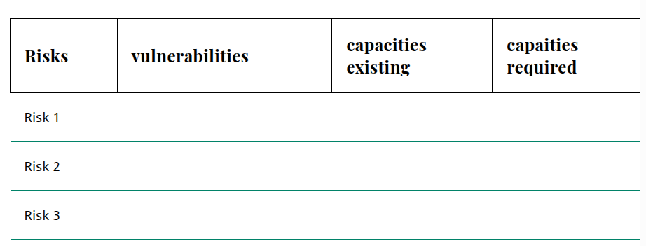
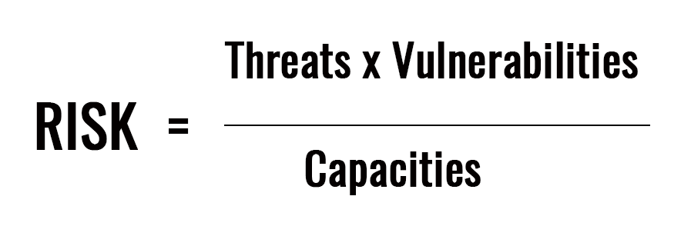
Risk assessment (risk vs likelihood)
Physical, Digital, Legal including Crown Jewels
(risk vs likelihood)
Risk
Sensitive Data
Likelihood
Practical or Not? Unsure within NGO context
(lots of time & resources required)
Ref:
Safetag - Activity: Sensitive Data
Safetag - Activity: Risk Modelling Assessment
FLD - Analysing Risk - Risk Formula
Holistic Security - Identifying & Analyisng Threats

Slide 25
Open Tech Camp - Data Classification
Discussion
  CONFIDENTIAL/SECRET
  (For recipients only-/no sharing, huge/devastating impact if leaked limited)
  INTERNAL
  (Limited recipients & sharing-For organisation, partners/collective use only, large impact if leaked - limited sharing)
  PRIVATE
  (Limited recipients & sharing or individuals, organisation, partners & their community only. Some impact if leaked/shared)
  PUBLIC
  No Limits. Is available on website
Notes:
https://github.com/Sinar/knowledgemgmt/issues/6

Slide 26
Sinar Traffic Light Protocol
TLP 2.0 for Sharing
  TLP: RED (For recipients only, no further disclosure)
  TLP: AMBER (Limited disclosure to recipients
  - need-to-know basis within org, community-peers
  & partners organisation Add +STRICT for within org only)
  TLP: GREEN (Limited disclosure to recipients
  and their community-peers & partners organisation
  but not via publicly accessible channels).
  TLP: CLEAR (No limit on disclosure to recipients
Notes:
Sinar TLP Concept Note https://docs.google.com/document/d/1s6Fm72eO8RfkR4uQDpwhv4BtDD9dEqIEG73dOCYIkgM/edit?tab=t.0

Slide 27
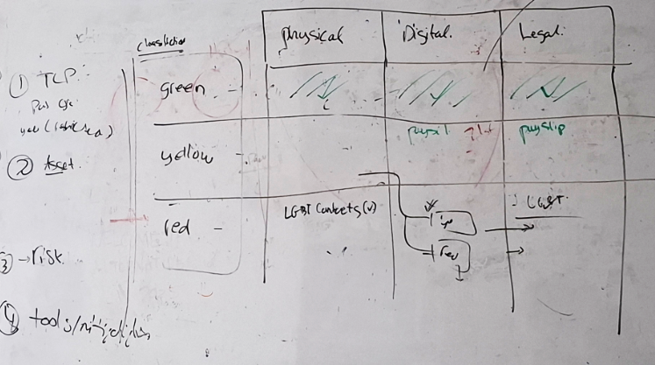
Mapping or data inventory
A rough whiteboard sketch of what we thought an intuitive flow mapping for civil society/non profit may look like

Slide 28
Intuitive Flow? Try this template for mapping
Classifier | Physical | Digital | Legal
Green / Private
Yellow / Confidential
Red / Restricted

Slide 29

Zero Trust
Trust, but always check (towards automation?)
Access
  (username, passwords, accounts)
Insider Threats
  (current staff, ex-staff - accidental & intentional and/or spies)
Tech (evolution from traditional VPN)
  Zero Trust Access
  Zero Trust Network
Notes:
https://n8n.io/
Local server providing n8n hosting https://www.gbnetwork.my/servers/n8n-vps/

Slide 30
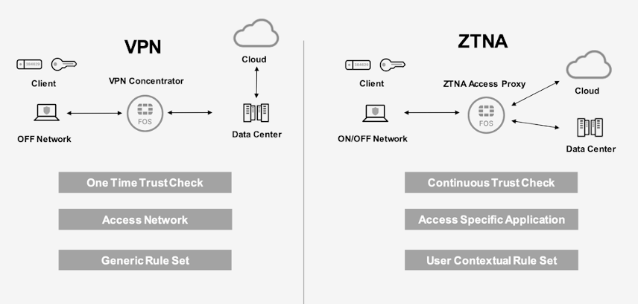
Zero Trust

Slide 31

Summary
We refreshed our knowledge in a localised context of knowledge & framework
Due to lack of time, there’s a lot of other details we could not cover
Tips(Framework) over tools
The strategies involves a combination of smart digital security practices and legal awareness
Notes:
Recap: Briefly summarize the key takeaways: digital security is about protecting your data, the threats are real and specific to civil society, and it involves a combination of smart practices and legal awareness.
Transition to Next Session: "My goal today was not to give you all the answers, but to give you the context for why you should care. The next session, 'Digital Security 101,' will show you the how—the practical steps to implement the strategies we've discussed."
Final Encouragement: End on a positive and empowering note. "This is not about being a security expert, but about being an aware and prepared advocate for your organization and the communities you serve."

Slide 32
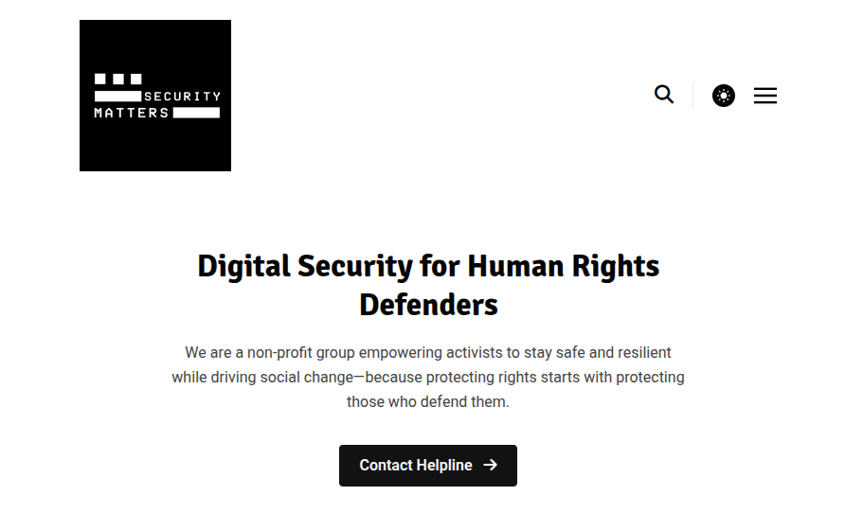
Resources: Security Matters
Security Matters
- Malaysian NGO focusing on digital security
& related capacity building in the region
(trainers network, train the trainers, threat assessment, helpline)
Security Matters https://securitymatters.asia

Slide 33
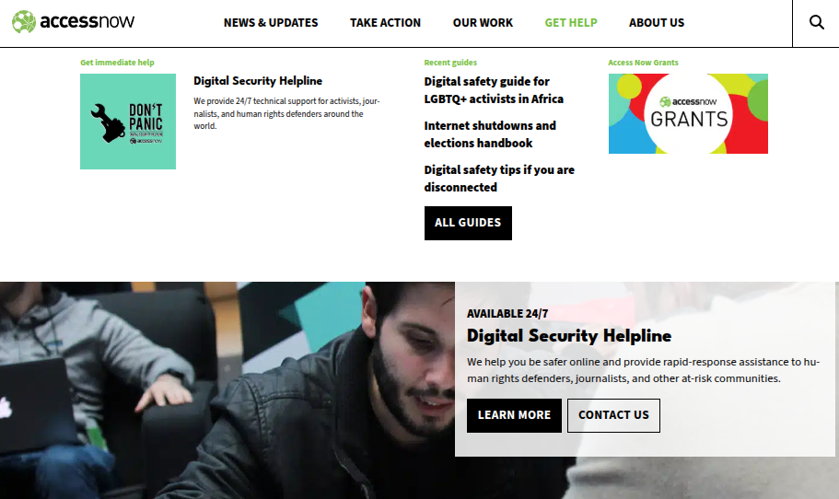
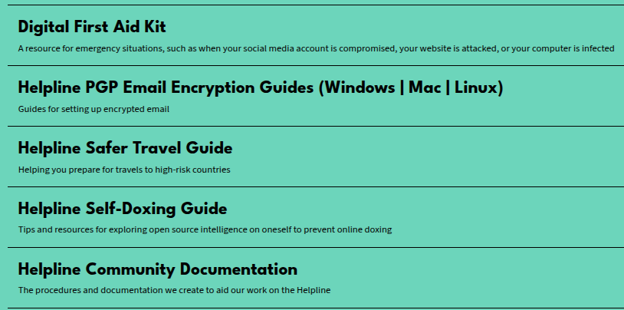
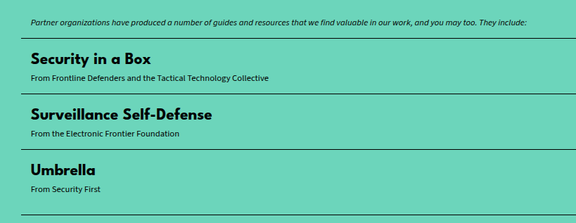
Resources: AccessNow
AccessNow
- Global NGO focusing on digital security
& related tools,
capacity building
With partners
(digital safety resources, helpline)
AccessNow https://www.accessnow.org/resources/

Slide 34
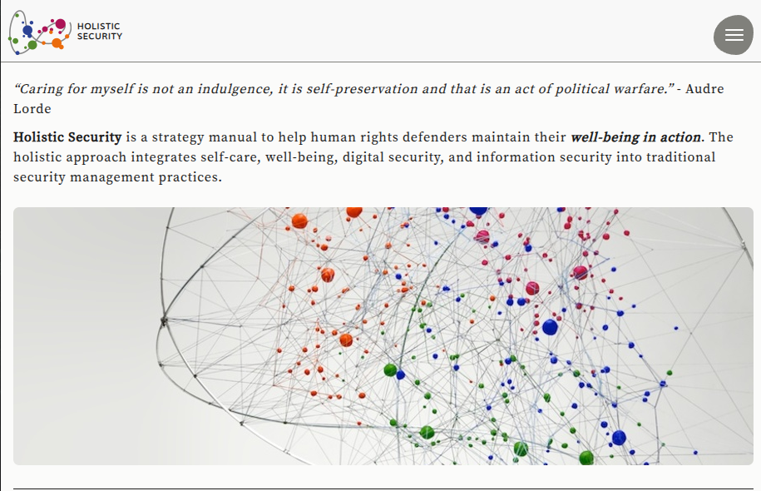
Resources: Holistic Security
Holistic Security is a strategy manual, created by Tactical Tech, to help human rights defenders maintain their well-being in action.
Holistic Security https://holistic-security.tacticaltech.org/

Slide 35
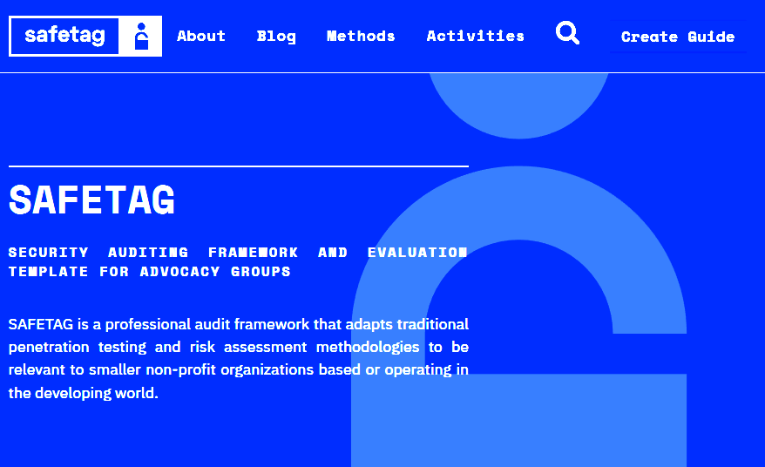
Resources: SafeTAG
SAFETAG -
Security Auditing Framework and Evaluation Template For Advoacy Groups
Adapted risk assessment relevant to smaller non-profits in
the developing world
Safetag https://safetag.org/

Slide 36
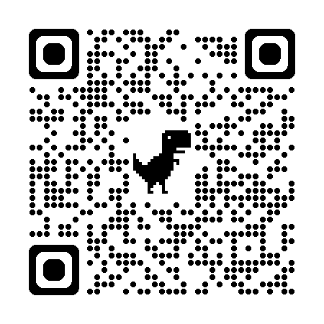
Contact me
Contact me at sam@sinarproject.org
or via LinkedIn
(QR code for sessionize link to profile)
https://sessionize.com/sam-ng/
Notes:
Recap: Briefly summarize the key takeaways: digital security is about protecting your data, the threats are real and specific to civil society, and it involves a combination of smart practices and legal awareness.
Transition to Next Session: "My goal today was not to give you all the answers, but to give you the context for why you should care. The next session, 'Digital Security 101,' will show you the how—the practical steps to implement the strategies we've discussed."
Final Encouragement: End on a positive and empowering note. "This is not about being a security expert, but about being an aware and prepared advocate for your organization and the communities you serve."

Slide 37
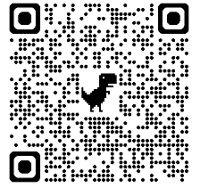
Feedback/Survey
Appreciate your time & input
Helps us make it better (really!)
https://forms.gle/meBFcY7izHWpLF5w7
Notes:
Recap: Briefly summarize the key takeaways: digital security is about protecting your data, the threats are real and specific to civil society, and it involves a combination of smart practices and legal awareness.
Transition to Next Session: "My goal today was not to give you all the answers, but to give you the context for why you should care. The next session, 'Digital Security 101,' will show you the how—the practical steps to implement the strategies we've discussed."
Final Encouragement: End on a positive and empowering note. "This is not about being a security expert, but about being an aware and prepared advocate for your organization and the communities you serve."

